Slide 1
Synergy in action: getting more than we anticipated Part 1 Diverse projects – common themes Part 2 Collaboration : What are the benefits and fears?
Dominic Bygate, Gus Cameron,
Mark Clements, Karen Leslie, Mark Russell
Universities of Bristol, Exeter, Hertfordshire and Westminster

Slide 2
Gus Cameron
University of Bristol

Slide 3
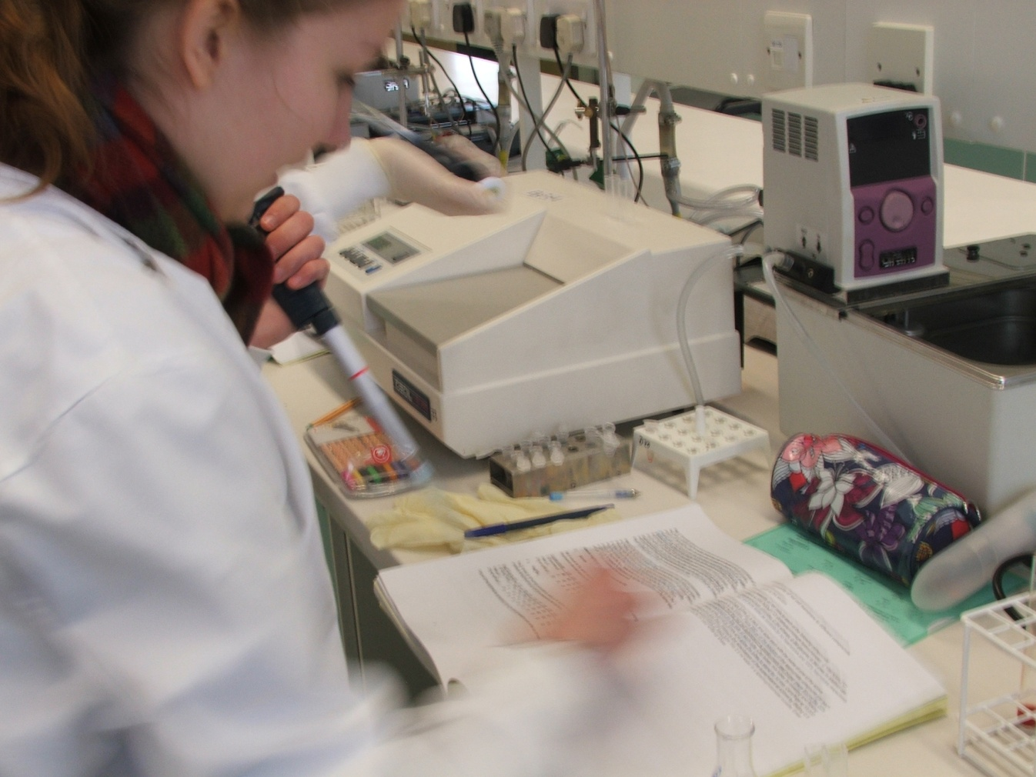
First-year students and attitudes to lab work

Slide 4
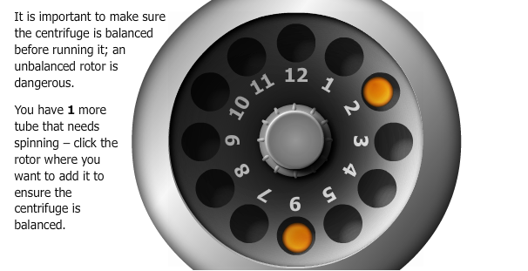
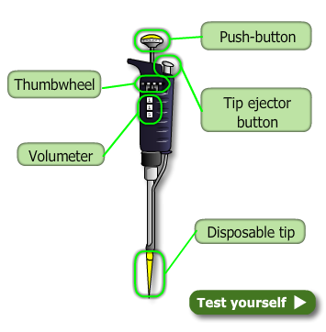
Experimental information

Slide 5
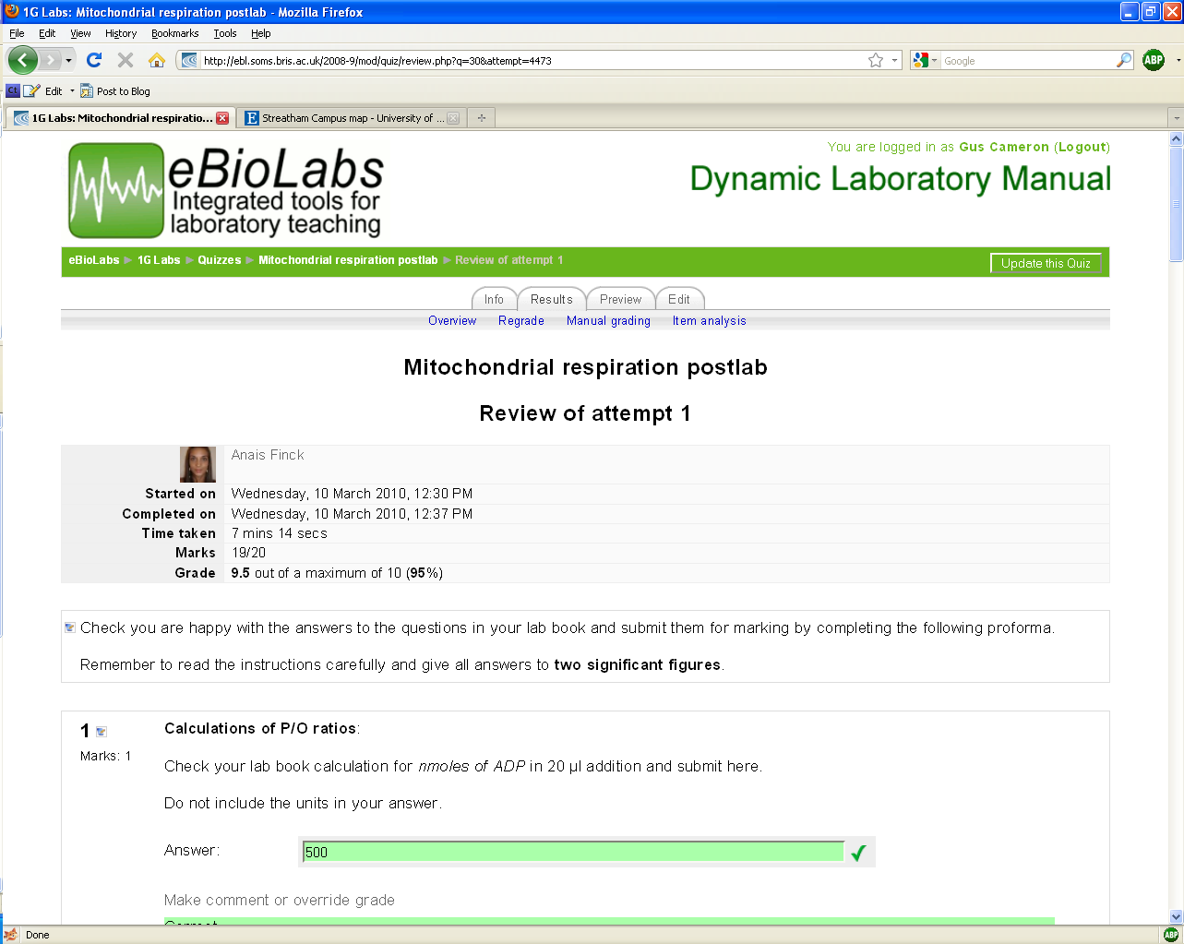
Testing understanding

Slide 6
eBiolabs makes a difference…
~7000 student contact hours supported.
~5000 student assignments managed.
Significant differences between eBiolabs students and non-eBiolabs students.
Reflects way students want to learn.
Staff report higher level conversations.
~ 40 staff days saved.

Slide 7
Making Assessment Count
Mark J.P. Kerrigan, Mark Clements, Andrew Bond, Federica Oradini, Yanitsa Nedelcheva & Gunter Saunders
School of Life Science and Westminster Exchange

Slide 8
Making Assessment Count
Perception that students are not using feedback effectively to improve their learning
Students often find it difficult to contextualise feedback and use it strategically particularly during the transition to studying at University
Funding awarded from JISC to try to address this issue
Developed a student-centred, Web 2.0 process for reflection on feedback (e-reflect)

Slide 9
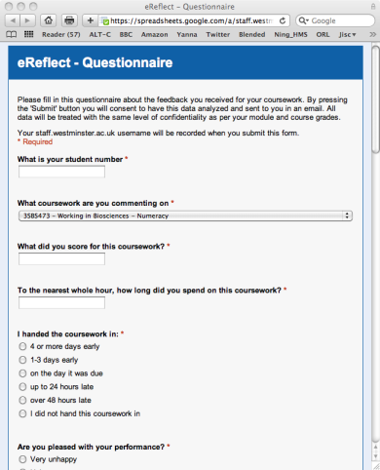
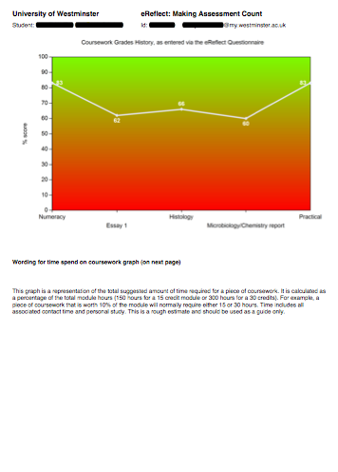
The Process
Subject Feedback
Diagnostic Questionnaire
Automated Report
Learning Journal
Share with Tutor

Slide 10
Evaluation
Process evaluated with 360 1st year Bioscience students and 36 personal tutors
One round of reflection compulsory
~ 50 % students completed >3 cycles of reflection
Majority of students positive about the process but tutors less so….
Tutor engagement key to student participation

Slide 11
Lessons Learnt
Technology should be as simple as possible
Use student champions to encourage uptake
Engage staff early in project
Project has altered the way staff give feedback
Senior management involvement key to sustainability

Slide 12
Karen Leslie, Laura Taylor, Liz Dunne
Education Enhancement Unit University of Exeter

Slide 13
How to promote a learning ethos in which students actively participate and engage
How to manage assessment and feedback with large numbers
How to promote a collaborative community in which diversity is both valued and well-catered for

Slide 14
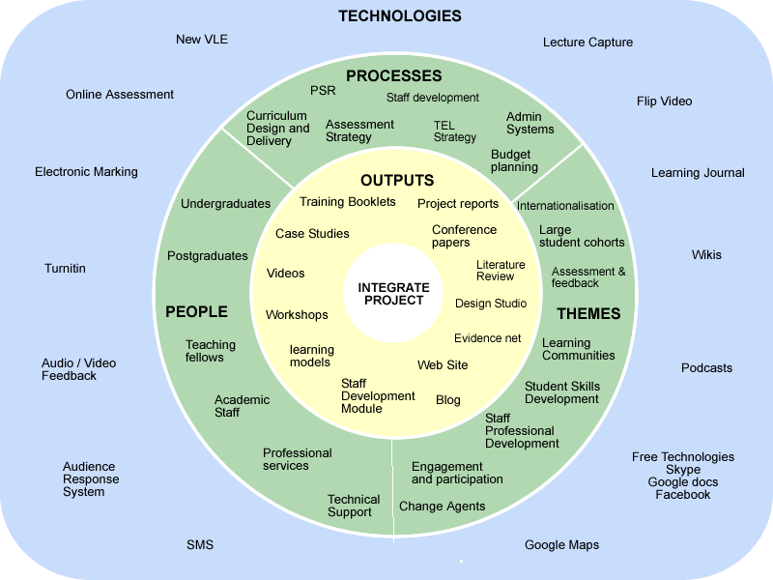

Slide 15
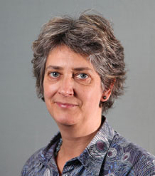

Slide 16
Creating change one conversation at a time…….
In a seemingly complex project find brilliant people and small simple things that work. Our project has been very flexible and responsive to need
The breadth and depth of the project has helped build a critical mass of people and the readiness for change in the Business School
Staff and Students are our agents for change
People : Relationships : Conversation : Confidence Bravery : Persistence : Enjoyment

Slide 17
Effecting Sustainable Change in Assessment Practice and Experience ESCAPE
Mark Russell/Dominic Bygate
University of Hertfordshire
Notes:
We know assessment is important
Current Assessment Landscape:
hiden curriculum
end loaded assessment
lack of consistent engagement across a semester
lack of opportunities for formative feedback
Increasing student numbers
Student module choices influenced by assessment type
NSS, the student perspective?
Learning is a function of assessment

Slide 18
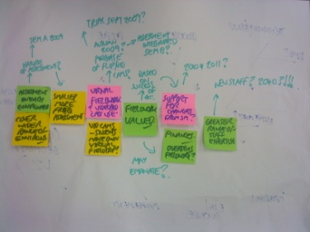
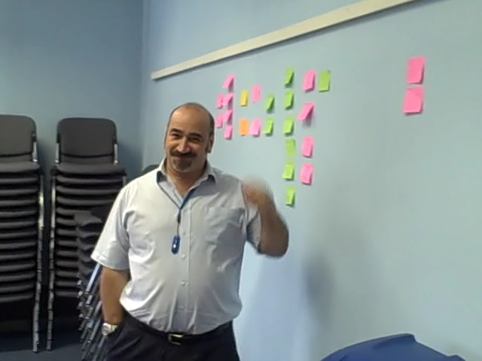
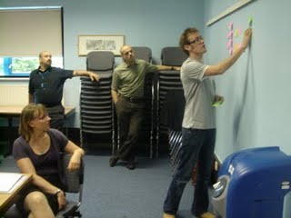
Respond to the challenge on a local level
Notes:
Respond to the challenge on a local level
we know good practice exists
but……‘lone ranging is not enough’
unearth good practice at modular level
empower individual modular teams to nurture and propagate their good practice
plan for sustainability and collateral effects
good assessment is the right of all our students
We chose an Appreciative Inquiry approach:
looks at positives
gets teams engaged quickly
focuses teams on their practice
empowers individuals and teams to make a difference
ownership of change is with module teams
leads to sustainable change

Slide 19
Changing thinking:
Good assessment for learning…
…engages students with the assessment criteria
…supports personalised learning
…ensures feedback leads to improvement
…focuses on student development
…stimulates dialogue
…considers student and staff effort
Notes:
a synthesis of some of the guidance into a manageable collection.
The significant influence of assessment on student study behaviours, their approach to learning and ultimately student learning is a recurrent theme in the educational literature (Biggs, 2003; Ramsden, 1994; Rowntree, 1977; Snyder, 1970).
Conditions under which assessment supports students' learning (Gibbs & Simpson, 2004)
Principles of good assessment and feedback practice (Nicol, 2007)
Principles of effective assessment (NUS)
Assessment Standards Manifesto (Weston-Manor-Group, 2007)

Slide 20
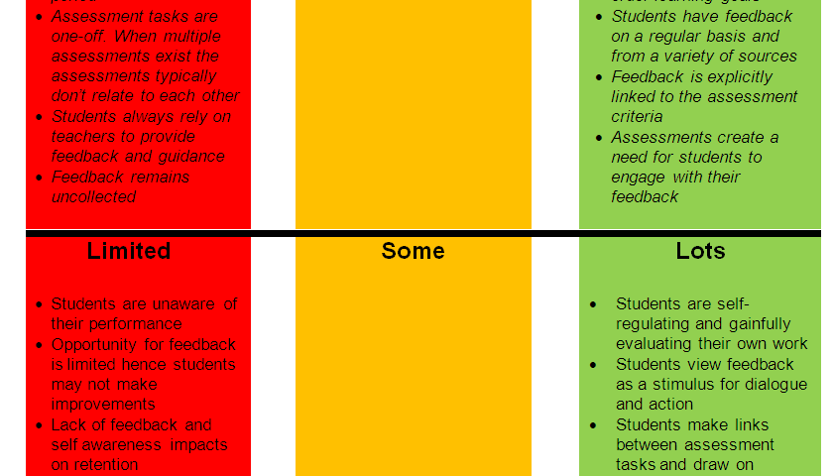
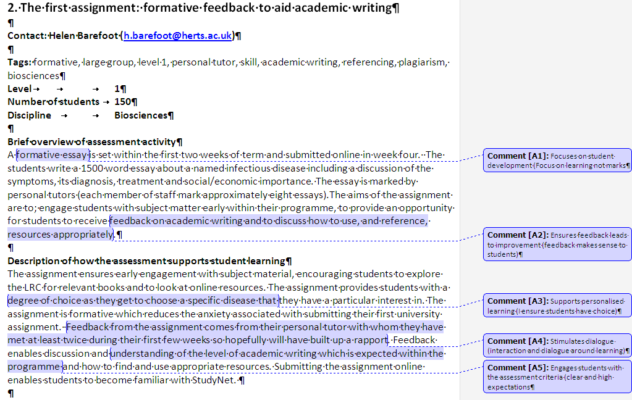
Assessment for Learning: A Tool Kit approach to staff engagement
Assessment for Learning Diagnostic
Features and Consequences
Range of examples
Notes:
a synthesis of some of the guidance into a manageable collection.
The significant influence of assessment on student study behaviours, their approach to learning and ultimately student learning is a recurrent theme in the educational literature (Biggs, 2003; Ramsden, 1994; Rowntree, 1977; Snyder, 1970).
Conditions under which assessment supports students' learning (Gibbs & Simpson, 2004)
Principles of good assessment and feedback practice (Nicol, 2007)
Principles of effective assessment (NUS)
Assessment Standards Manifesto (Weston-Manor-Group, 2007)
Good assessment for learning…
engages students with the assessment criteria
…supports personalised learning
…ensures feedback leads to improvement
…focuses on student development
…stimulates dialogue
…considers student and staff effort

Slide 21
Emerging Themes
Engaging staff
Efficiency Vs Effectiveness
Use technology to support the pedagogy
Sustainability
Notes:
Relationship with module team is key to success
AI has worked to build relationship and grow local solutions
changes are in some cases over longer period than at first envisaged
different teams at different stages
sustainability is fundamental to project
It’s about the pedagogy not the technology
collateral effects important

Slide 22
Collaboration….
Getting away from the day-to-day
Finding others in the same boat
Meeting with openness and honesty
Sharing thinking, airing challenges
Gaining fresh perspectives
Building a shared experience
Sustaining energy, confidence, focus

Slide 23
The way forward:
What barriers do we face when embedding new tools and approaches within our institutions?
How can we make projects sustainable?
What are the most effective ways of disseminating good practice across the sector?

Slide 24
Synergy in action: getting more than we anticipated 2
Dominic Bygate, Gus Cameron,
Mark Clements, Karen Leslie, Mark Russell
Universities of Bristol, Exeter, Hertfordshire and Westminster

Slide 25
Collaboration of four 2 year (October 2008-2010) JISC Funded ”Transforming Curriculum Delivery through Technology” Projects
Notes:
four projects with different contexts and delivery goals
Explain why the cluster
Talk about the common themes
The role of the critical friend at the start
Also consultants like Rachael Harris – their role
Mention the curriculum design strand – aims, numbers involved, chances for synergy in shared JISC run meetings

Slide 26
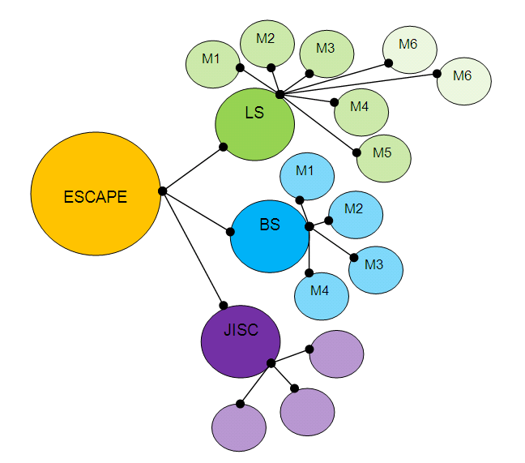
The many and varied interactions

Slide 27
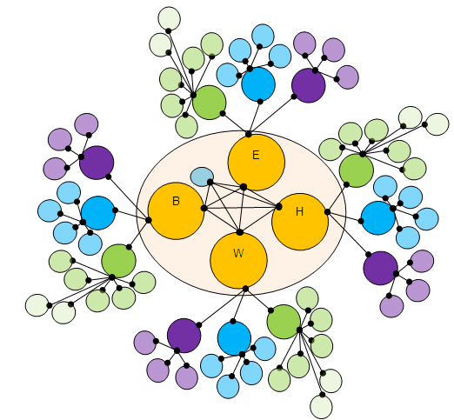
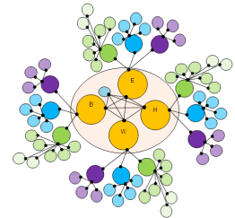
The cluster (s)

Slide 28
Collaboration: What are the benefits/fears?
Notes:
Discussion:
What are the perceived benefits?
What are the fears?

Slide 29
Meet face to face every six months
Planned and facilitated
Chatham House rules
Supportive learning community
Work across formal boundaries
Space to test ideas and validate practice
Notes:
Originally Collaborative Approaches to the Management of E-Learning
“Camels are versatile animals and can operate in the harshest of conditions, surviving on the poorest vegetation. They produce milk for nutrition and dung for fuel as well as providing transport. There are a lot of parallels with the versatility of e-learning in making learning happen in places where it wouldn't otherwise be possible”
Explanation of how we work
Working across formal boundaries and meeting face to face every six months, in a planned, facilitated CAMEL cluster, has enabled us to build a supportive learning community, which has provided a space for testing our ideas and validating our practice

Slide 30
The CAMEL meetings
Project start
Project finish
C1
C2
C3
C4

Slide 31
Our Collaboration
Notes:
Has allowed us to share:
Engaging & working with others is the most important part of shifting thinking and practice
Change is result of a cumulative effect – relationship building activities, build confidence in others, develop and se change agents
Change is a complex and inexact process – the cluster supports us in working in this way

Slide 32
How can we ensure a project fails?

Slide 33
What works for us
Build positive relationships
Facilitate positive conversations
Understand and exploit why people innovate
Accept that the rate of change is variable and not constant
Identify and work with all relevant stakeholders.
Build on informal and formal learning processes / activities
Build structures that facilitate collaboration, sharing and mutual support
Create opportunities to evaluate the on-going performance of the project

